Slide 1

Right Vows
Submitted By: Gayathri Giridharan Project Guide:
Raji Miss
Course: MCA S6
MCA 2nd YEAR
Dept of MCA

Slide 2
contents
Abstract
Modules
Technology hierarchy
System specification
Table Design
UML
Forms

Slide 3
ABSTACT
Consultants offer advice and expertise to organisations to help them improve their business performance in terms of operations, profitability, management, structure and strategy. ...
The work stretches across a variety of areas, including management, strategy, IT, finance, marketing, HR and supply chain

Slide 4
Module description
Admin App ( android & IOS application)
Mobile App ( android & IOS application)
Web portal
Admin App (Mobile Application-android & IOS application
Login
Post a job
See all listed jobs
View users
Testimonial
About us
Contact us
View suggestions
Post Walk in jobs

Slide 5
Login
Admin can install the app on multiple device and login by entering the username and password.
Post a job
Job id - System generated job id for every job and should be unique
Option to add
Job Tittle , Job Description, Expiry Date , Email Id,
Number of additional documents to be attached and their name should set dynamically by admin
Qualification, Skills Required, Company Name, Experience Required
Location , Gender , Nationality

Slide 6
See all listed jobs
Option to Edit , Delete and Pause job
If paused a job user cannot apply to them anymore till it status change from pause to resume and it can’t list on user profile
View users
View all users applied for the current job opening
Option to sort users by job id, job title
Option to delete unwanted/fake users
Testimonial
Option to approve the testimonials from the users, approved testimonials can be listed on user app.

Slide 7
About us
Option to update the contents
Option to describe who we are ,Our Vision and Our Mission
Contact us
If there any queries from the users or need any help, they can send message from userapp will display on here
Add Walk in jobs
Option to add walk in jobs.
View Suggestions
If there any bugs or vulnerability they can report from user app will display on this module.

Slide 8
User App (Mobile application-android & IOS application
Sign up
Sign in
Jobs opening
Applied jobs
Add testimonial
Add Suggestion to admin
Contact admin
See Walk in job details

Slide 9
Sign up
To register as a user fill the following fields
Full Name
Nationality
Date of Birth
Current Location
Gender
Experience
Email
Qualification
Upload Photo
Upload Resume
Mobile Number
Enter OTP send to that number

Slide 10
Sign in
To Sign in to app enter the mobile number and enter the OTP send to that number.
Jobs opening
Receive Push notification when admin post a job
See all opening jobs
Option to view the detail of job
Option to apply the job
Applied jobs
Option to see all jobs he/she applied

Slide 11
Add Testimonials
Option to add reviews regarding the product
Add Suggestion to admin
If you have any queries regarding the security of product please free to contact them by entering your valuable suggestion here.
Contact admin
If you have any queries regarding this product please free to contact them by entering your valuable suggestion here.

Slide 12
Web portal
See all registered users
See all listed jobs
Filter users based on applied jobs
Download resume one by one or bulk download

Slide 13
Technology hierarchy
MOBILE APPLICATION – HYBRID
Cordova Ionic
Angular JS version .1
WEBPORTAL – RESPONSIVE
HTML
CSS
JQuery
Twitter Bootstrap
BACKEND
CODE-IGNITER
PHP
MySQL

Slide 14
Introduction to PHP
PHP is a server-side scripting language designed for web development but also used as a general-purpose programming language.
PHP code is usually processed by a PHP interpreter, which is usually implemented as a web server's native module or a Common Gateway Interface (CGI) executable.
My SQL
Structured Query Language (SQL), in computer science, a database sub language used in querying, updating and managing relational databases.
it provides the following features:
A variety of user interfaces
Physical data independence

Slide 15
Android
Android is a mobile operating system developed by Google, based on the Linux kernel and designed primarily for touch screen mobile devices such as smart phones and tablets.
NETBEANS
Netbeans is an integrated development environment (IDE) for developing primarily with Java, but also with other languages, in particular PHP, C/C++, and HTML5.
Among the features of the platform are:
User interface management (e.g. menus and toolbars)
User settings management
Storage management (saving and loading any kind of data)
Window management

Slide 16
IONIC FRAMEWORK
Ionic is a powerful HTML5 SDK that helps you build native-feeling mobile apps using web technologies like HTML, CSS, and JavaScript.
Ionic is focused mainly on the look and feel, and UI interaction of your app.
That means we aren't a replacement for PhoneGap or your favourite JavaScript framework.
Code-igniter
Features
Model-View-Controller Based System
Extremely Light Weight
Full Featured database classes with support for several platforms.
Query Builder Database Support
Form and Data Validation

Slide 17
System specification
Hardware specification
Processors : Intel Premium Pro or Processor running at 133 MHz
Hard Disk : 1.2 GB Hard Disk
RAM : Client Level – Minimum 128MB
Recommended Requirements for peak performance
RAM : Client Level – Minimum 512MB
Display Type : SVGA Colour Enhanced Monitor
Mouse : PS/2 2 Button

Slide 18
Software specification
Front End Tool : HTML, JavaScript, CSS, Twitter Bootstrap, Android, Ionic
Back End Tool : PHP, MySQL
Development tools : Net Beans
Operating System : Windows XP 7 Professionals and Higher
Browse : Google Chrome. Mozilla Firefox

Slide 19
Table design
Tbl_adminusers
FIELD | KEY | TYPE | DESCRIPTION
user_id | PK | bigint(10) | Id
user_name | No | varchar(200) | Name
password | No | varchar(300) | password
role | No | varchar(1) | Role

Slide 20
Tbl_applications
FIELD | KEY | TYPE | DESCRIPTION
application_id | PK | Bigint(10) | Id of application
Job_id | FK | Bigint(10) | Id of job
Job_code | No | Varchar(200) | Job code
Job_title | No | Varchar(300) | Job title
User_id | FK | Bigint(10) | Id of user
files | No | Varchar(200) | files
apply_time | No | datetime | Time of applying

Slide 21
Tbl_favorites
FIELD | KEY | TYPE | DESCRIPTION
fav_id | PK | bigint(10) | Id of favorite job
User_id | FK | bigint(10) | Id of user
Job_id | FK | Bigint(10) | Id of job

Slide 22
Tbl_jobs
FIELD | KEY | TYPE | DESCRIPTION
job_id | PKTYPE | bigint(10) | Id of job
job_code | No | Varchar(200) | Code of job
job_title | No | Varchar(200) | Title of job
main_category | No | varchar(200) | Main category
job_desc | No | text | Job description
Company | No | varchar(200) | Company name
Location | No | varchar(200) | Company location
job_place | No | varchar(200) | Job place
Salary | No | varchar(200) | Salary
email | No | varchar(200) | Email id
contact_number | No | Varchar(16) | Contact number
experince | No | Varchar(100) | experince
qualification | No | text | qualification
nationality | No | text | nationality
gender | No | Varchar(6) | gender
jobexpiry | No | date | Job expiry date
job_type | No | varchar(200) | Type of job
approved | No | tinyint(1) | approved

Slide 23
Tbl_recruter
FIELD | KEY | TYPE | DESCRIPTION
recruter_id | PKTYPE | bigint(10) | Id of recruter
password | No | Varchar(200) | password
company | No | Varchar(200) | company
name | No | varchar(200) | name
email | No | varchar(200) | email
mobile_number | No | varchar(200) | Mobile number
designation | No | varchar(200) | designation
address | No | text | address
location | No | varchar(200) | Location
bank_name | No | Varchar(200) | Bank name
account_number | No | Varchar(200) | Account number
swift_code | No | Varchar(200) | Swift code
country | No | varchar(200) | country
contact_name | No | varchar(200) | Contact name
company_address | No | varchar(200) | Company address
contact_number | No | varchar(200) | Contact number
company_email | No | varchar(200) | Company email

Slide 24
Tbl_suggestions
FEILD | KEY | TYPE | DESCRIPTION
suggestion_id | PK | bigint(10) | suggestion_id
subject | No | varchar(100) | subject
content | No | text | content
user_id | FK | bigint(10) | user_id
date | No | timestamp | date

Slide 25
Tbl_testimonials
FEILD | KEY | TYPE | DESCRIPTION
testimonial_id | PK | bigint(10) | Testimonial id
subject | No | varchar(100) | subject
company | No | varchar(300) | company
content | No | text | content
test_type | No | varchar(100) | Test type
user_id | FK | bigint(10) | User id
user_name | No | varchar(100) | User name
date | No | timestamp | date
approved | No | tinyint(1) | approved

Slide 26
Tbl_users
FIELD | KEY | TYPE | DESCRIPTION
user_id | PKTYPE | bigint(10) | Id user
fullname | No | Varchar(200) | fullname
nationality | No | Varchar(200) | nationality
dob | No | varchar(200) | Date of birth
current_loc | No | varchar(200) | Current location
gender | No | varchar(200) | gender
gcc | No | varchar(200) | Gcc experience
visa_status | No | varchar(200) | visa_status
email | No | varchar(200) | Email id
photo | No | Varchar(200) | photo
resume | No | Varchar(200) | resume
cover_letter | No | Varchar(200) | Cover letter
mobile_number | No | varchar(200) | Mobile number
cntry_code | No | varchar(200) | Country code
otp | No | varchar(200) | otp

Slide 27
Tbl_walkin
FIELD | KEY | TYPE | DESCRIPTION
job_id | PKTYPE | bigint(10) | job_id
job_code | No | Varchar(200) | Job code
position | No | Varchar(200) | position
description | No | text | description
Timing | No | varchar(200) | Timing
dates | No | varchar(200) | dates
email_id | No | varchar(200) | Email id
location | No | varchar(200) | Location
workplace | No | varchar(200) | workplace
company_name | No | Varchar(200) | Company name
contact_number | No | Varchar(200) | Contact number
website | No | Varchar(200) | website
source | No | varchar(200) | source
Posted_date | No | varchar(200) | Posted date
jobexpiry | No | date | Job expiry date
contact_number | No | varchar(200) | Contact number

Slide 28
Use case Diagram
Login
Manage jobs
Edit,Pause delete jobs
View suggestions
Manage testimonials
View testimonial
Accept testimonial
Admin
Post Walk in jobs
View users
About us

Slide 29
Sign up & sign in
Applicatn managmnt
Job manangmnt
View notification
send testimonials
send suggestion
Apply job
User
view all jobs
View applied jobs
Add favorire job

Slide 30
Activity diagram
Admin
Admin Side
Login
No
Yes
View users
Manage jobs
Edit,Pause,Delete jobs
View suggestions
Manage testimonial
View testimonial
Accept testimonial
Notifications
Post Walk in jobs
About us
Logout

Slide 31
Activity diagram
User
User Side
Login
No
Yes
Application management
Job management
View notification
Send suggestions
Send testimonial
View jobs
Apply jobs
View Applied jobs
Add Walk in jobs
Add favorite job
Logout

Slide 32
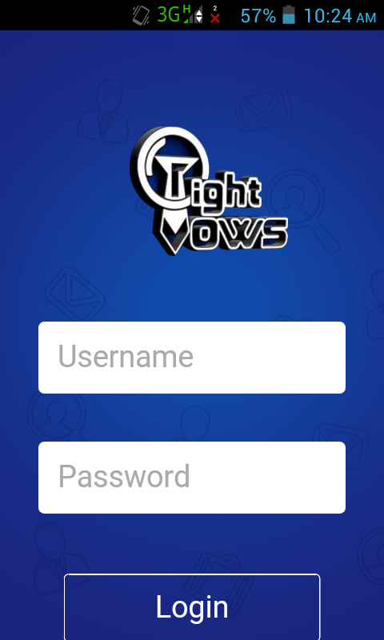
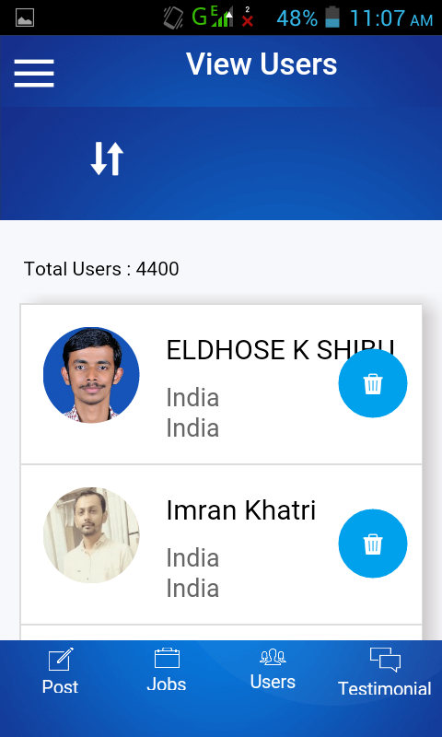
Form
admin

Slide 33
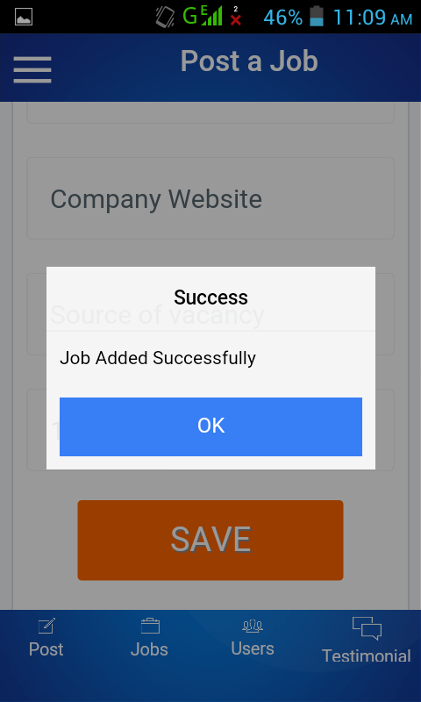
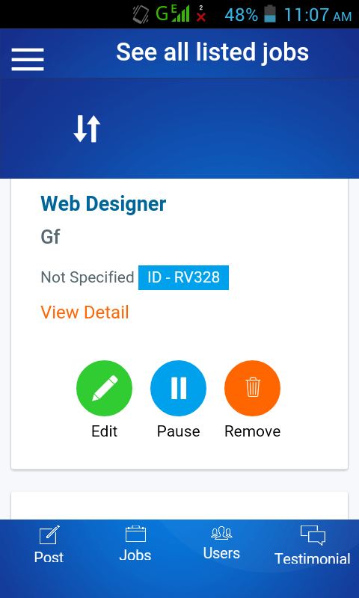

Slide 34
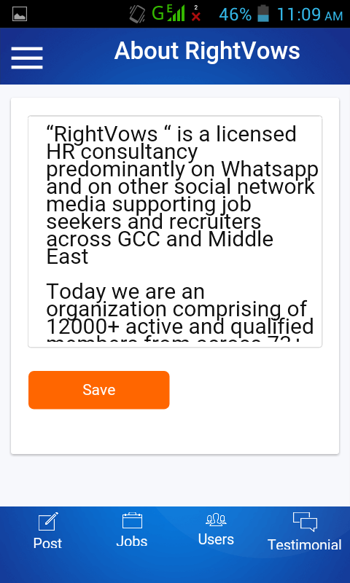
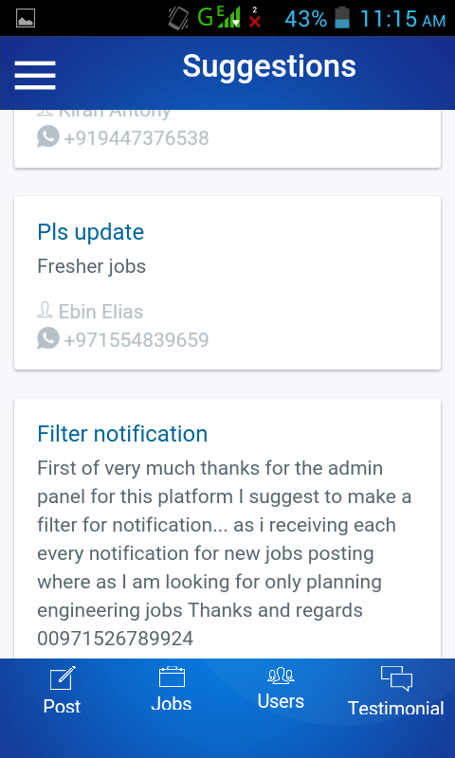

Slide 35
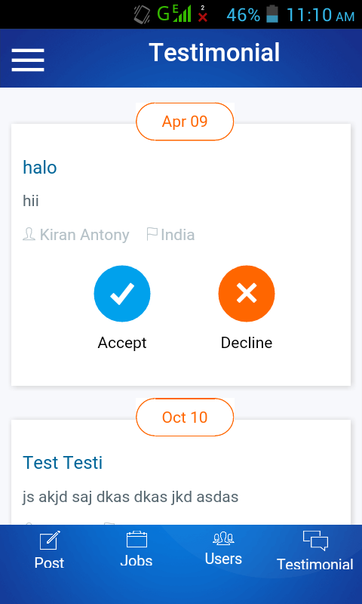
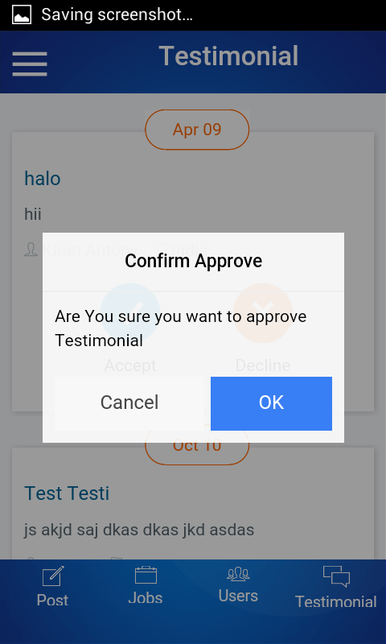

Slide 36
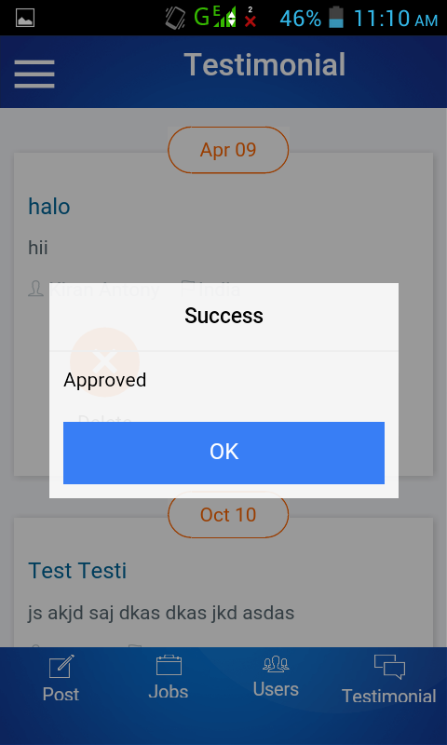

Slide 37
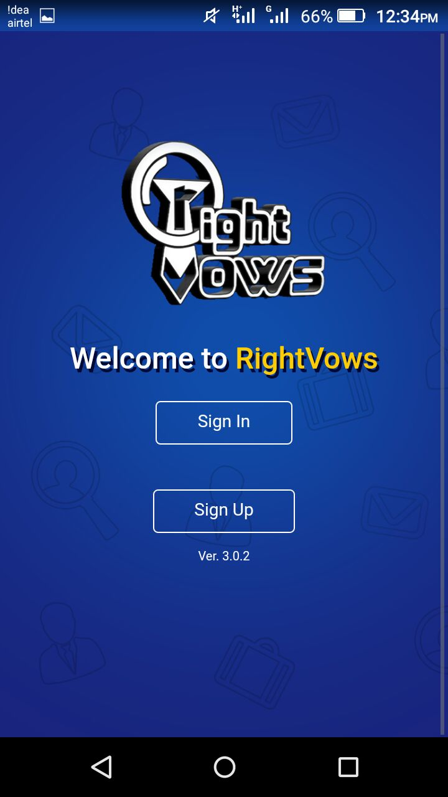
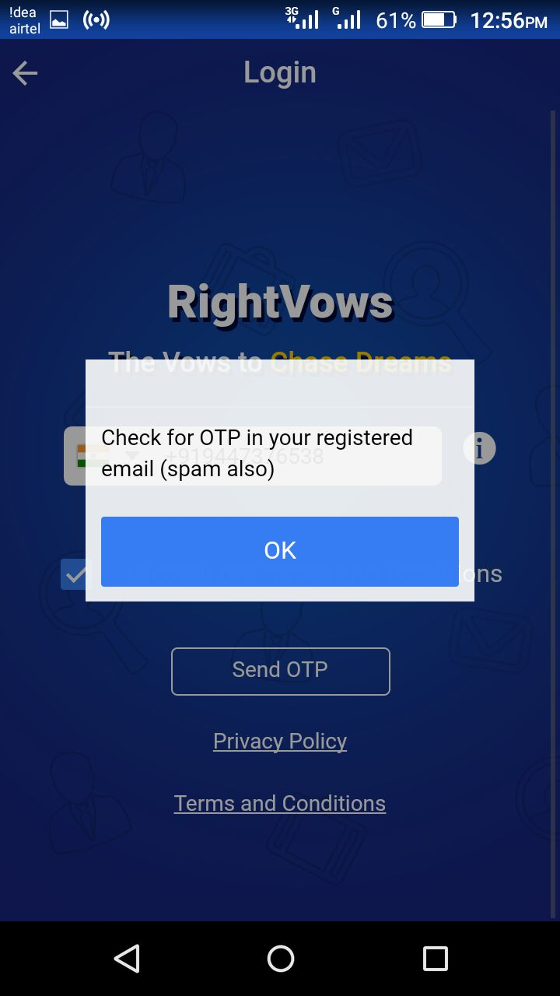
User

Slide 38
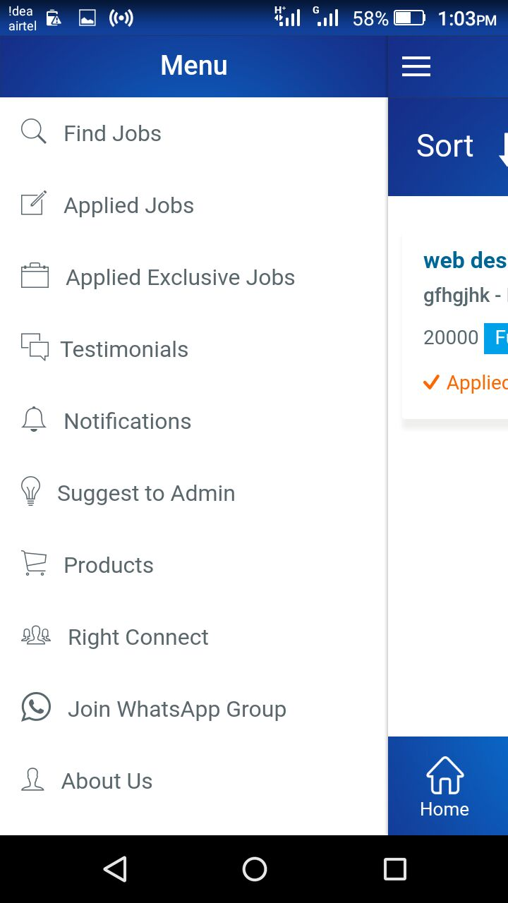
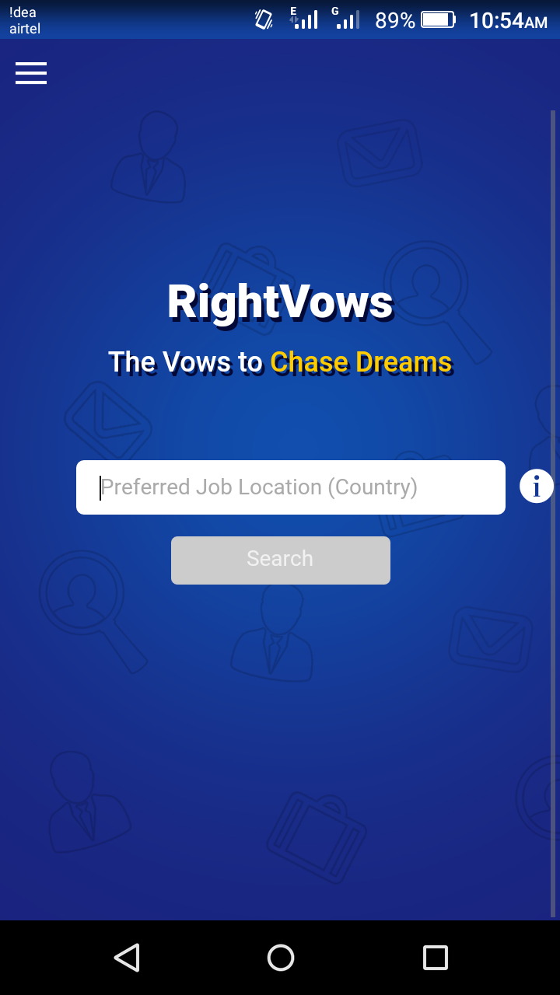

Slide 39
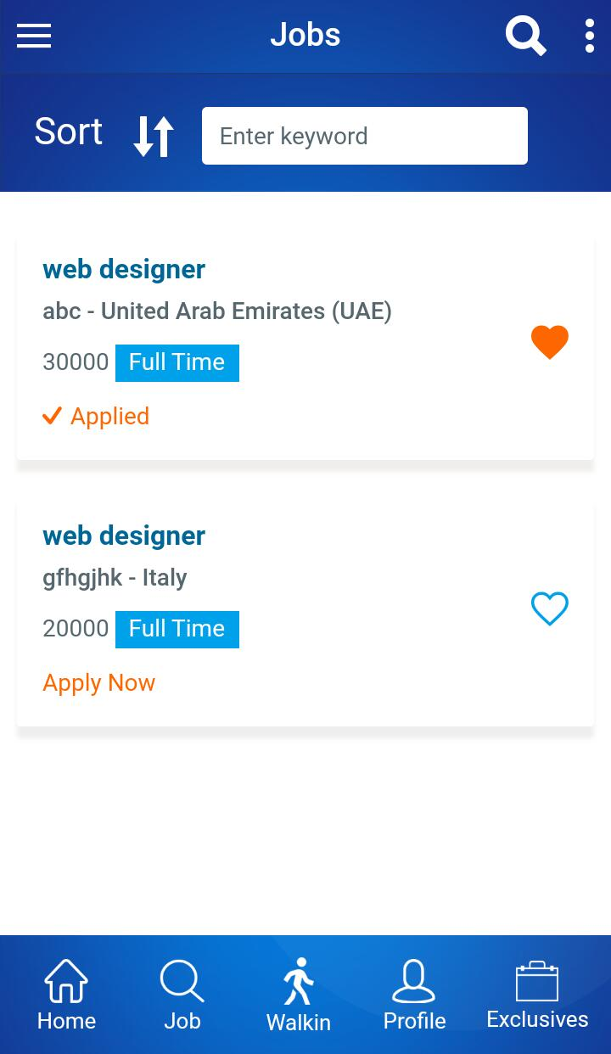
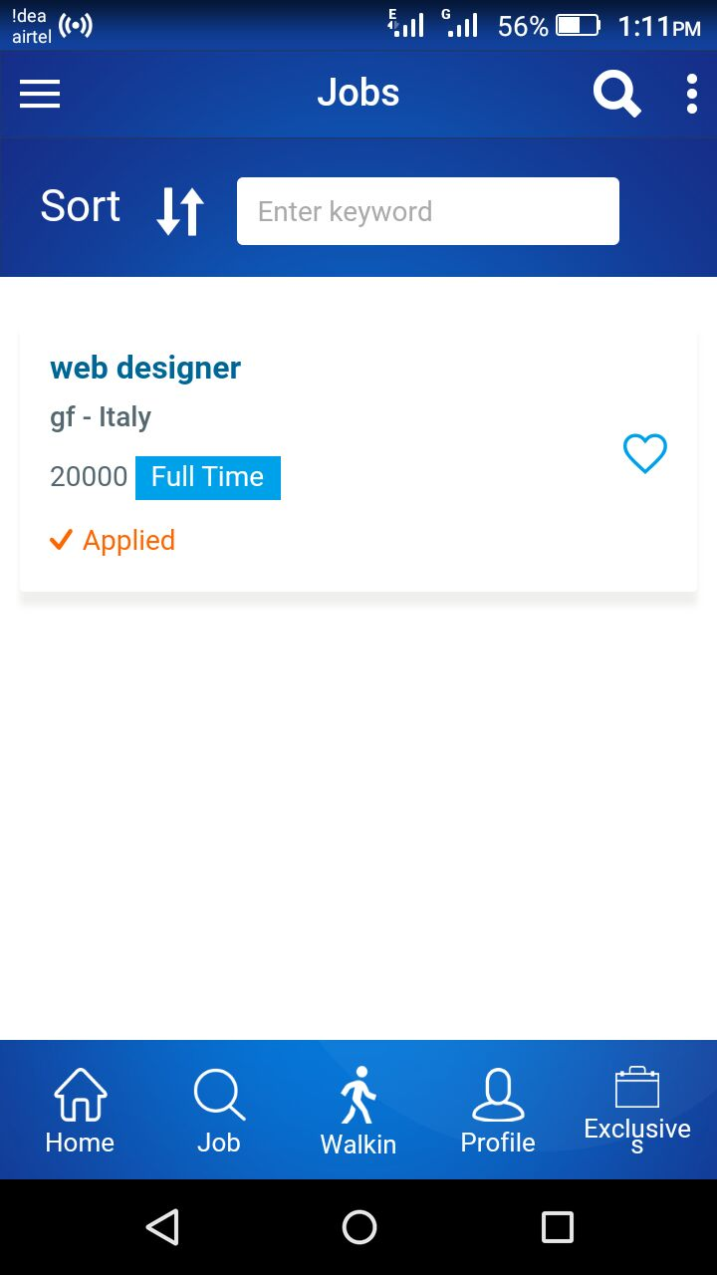

Slide 40
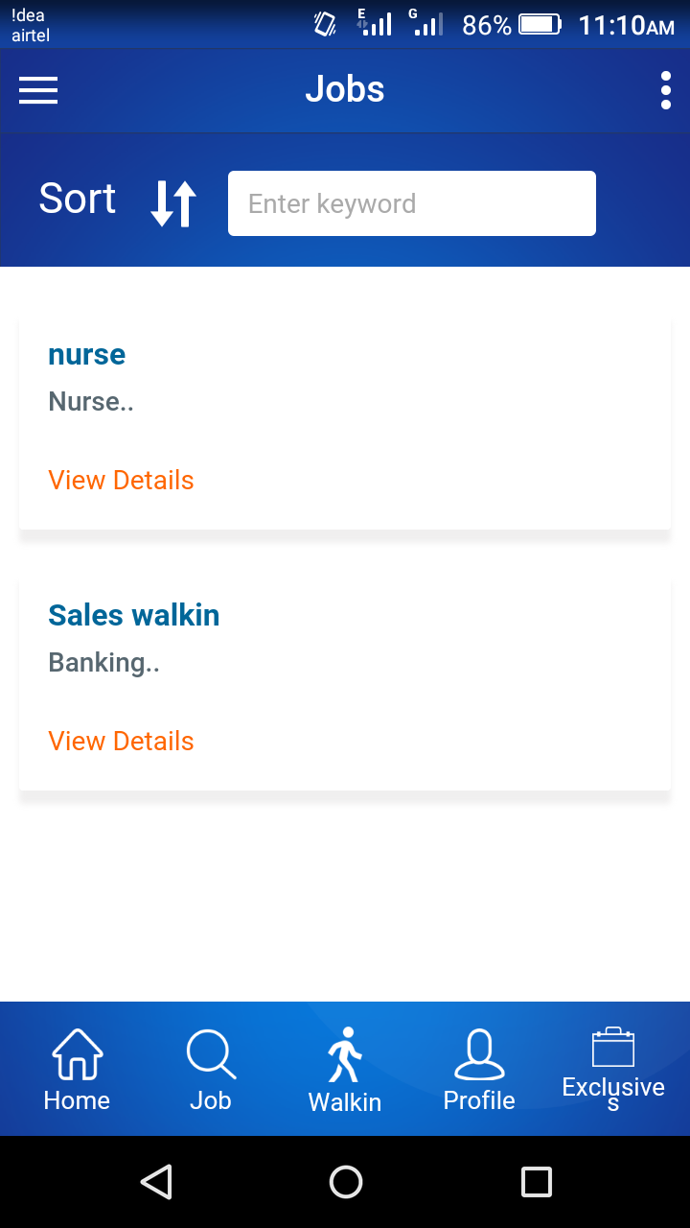
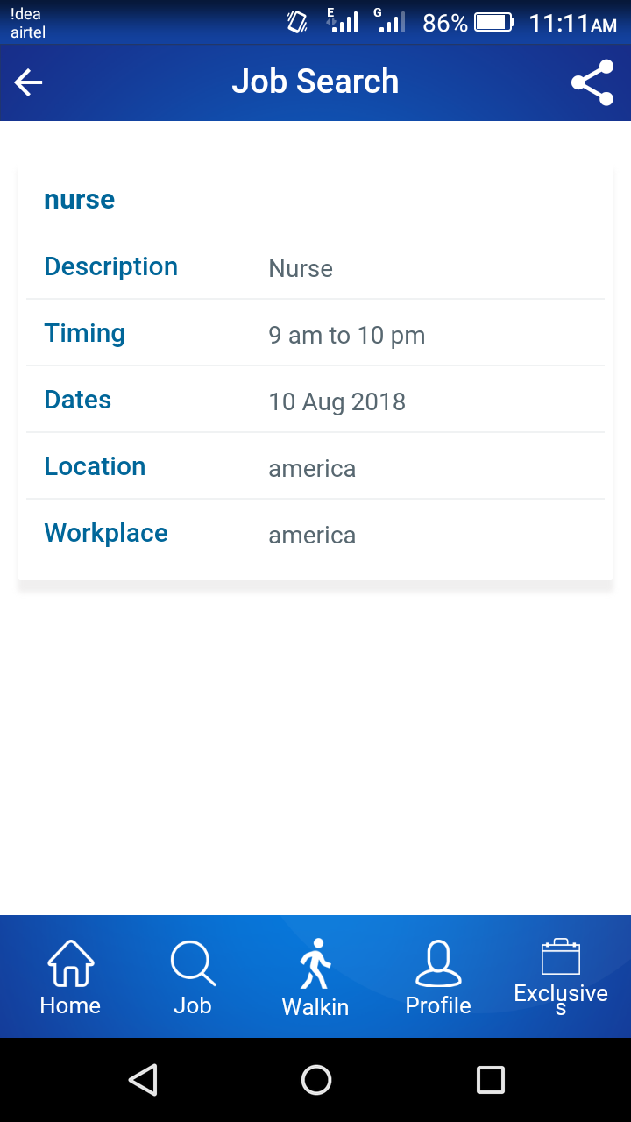
Walk in interview

Slide 41
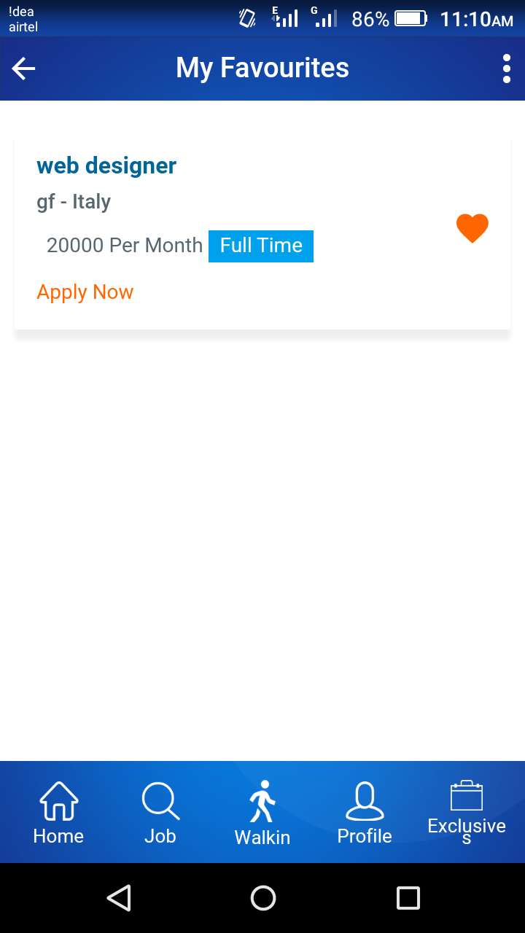
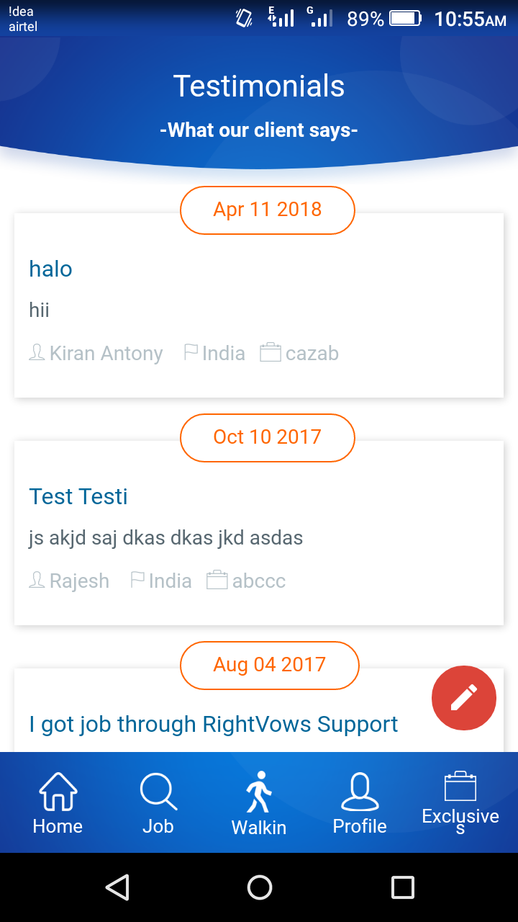

Slide 42
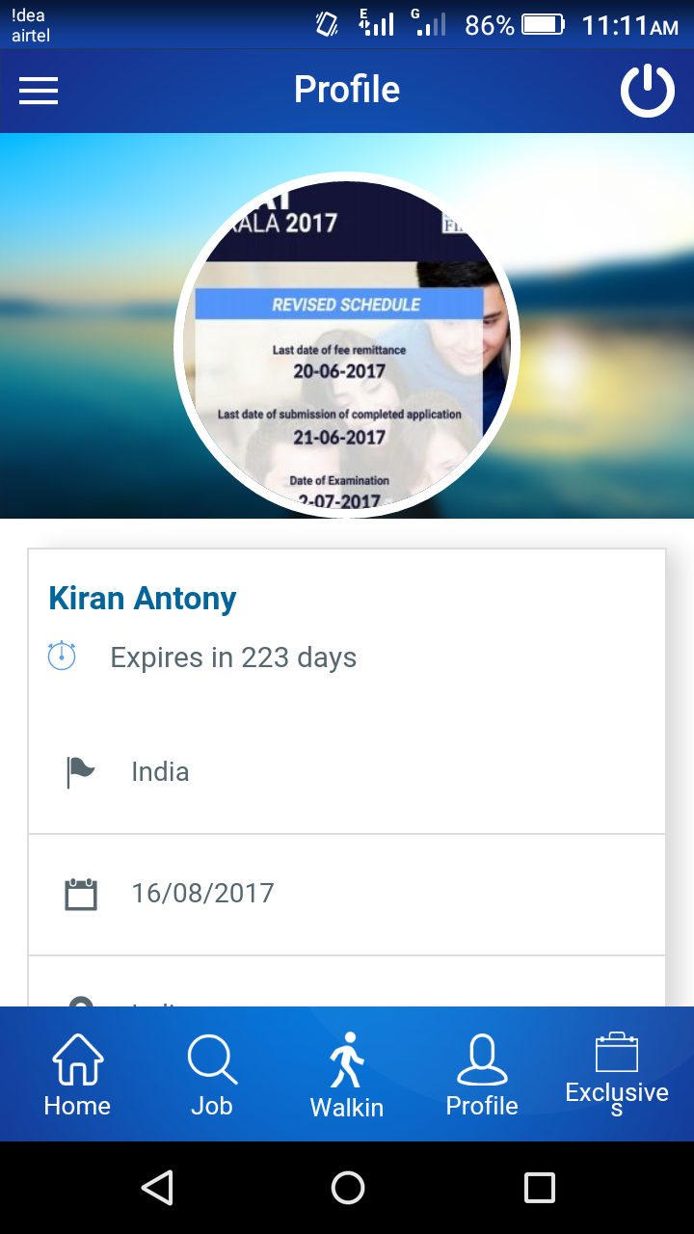
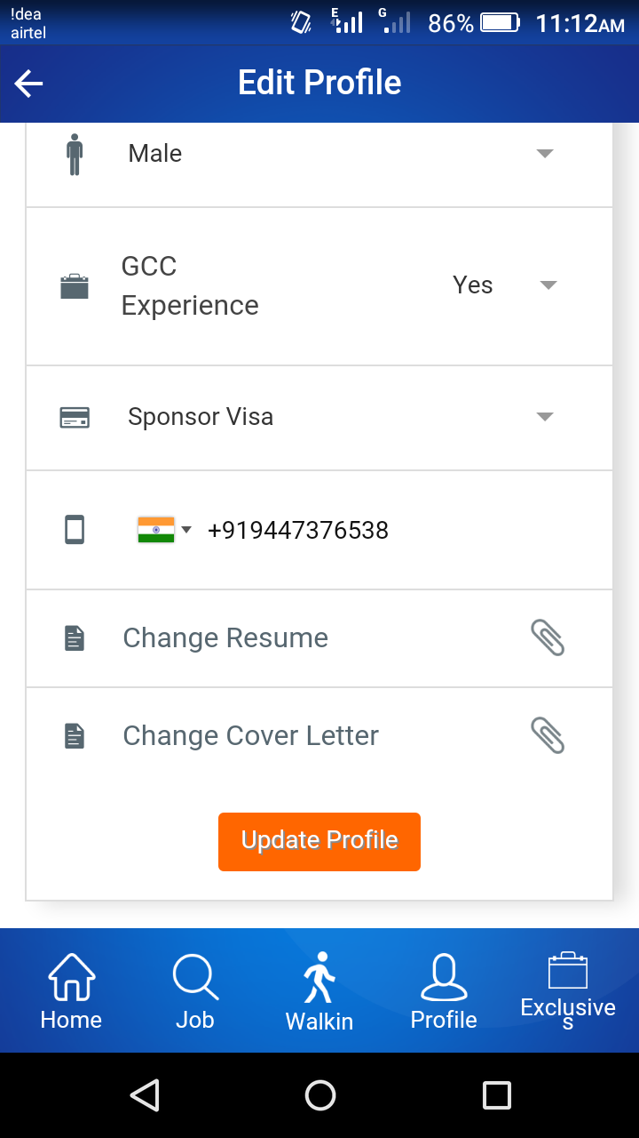

Slide 43
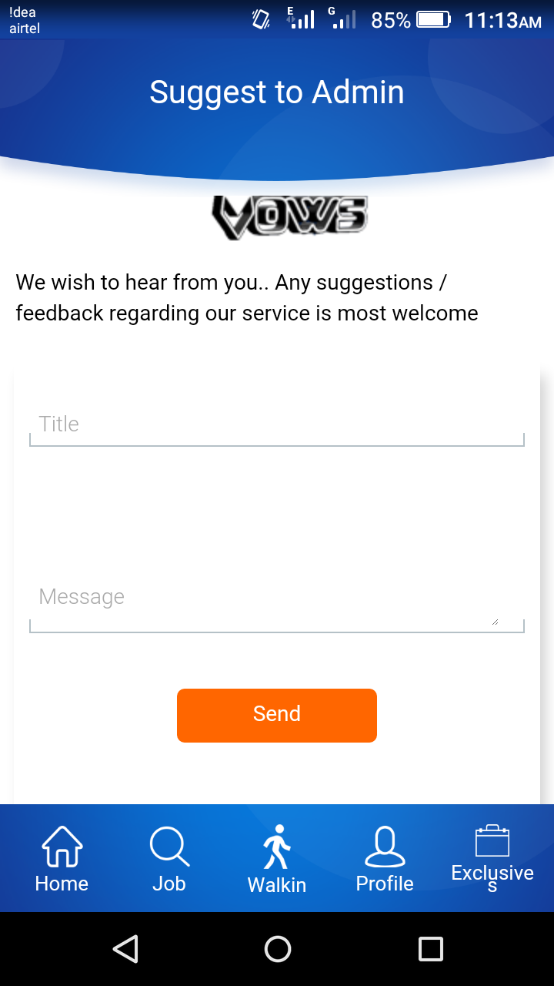
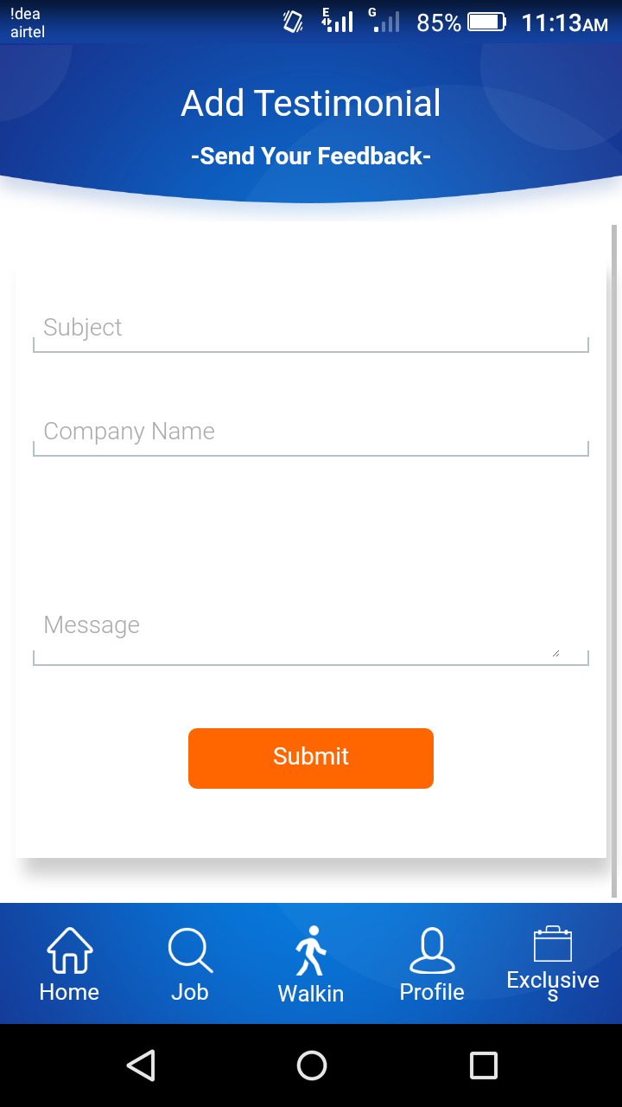

Slide 44
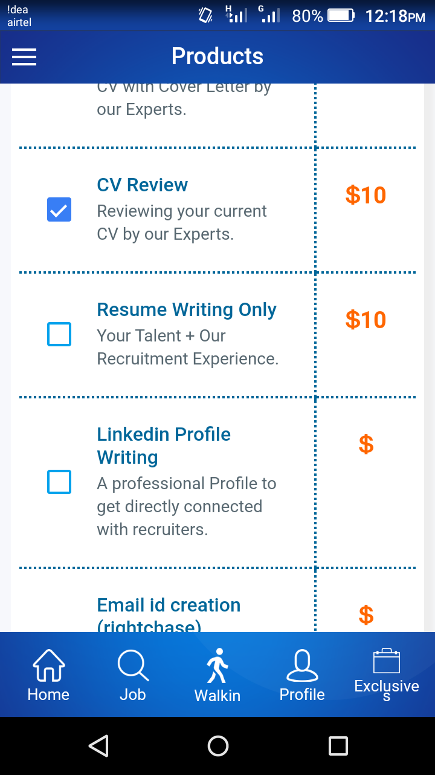
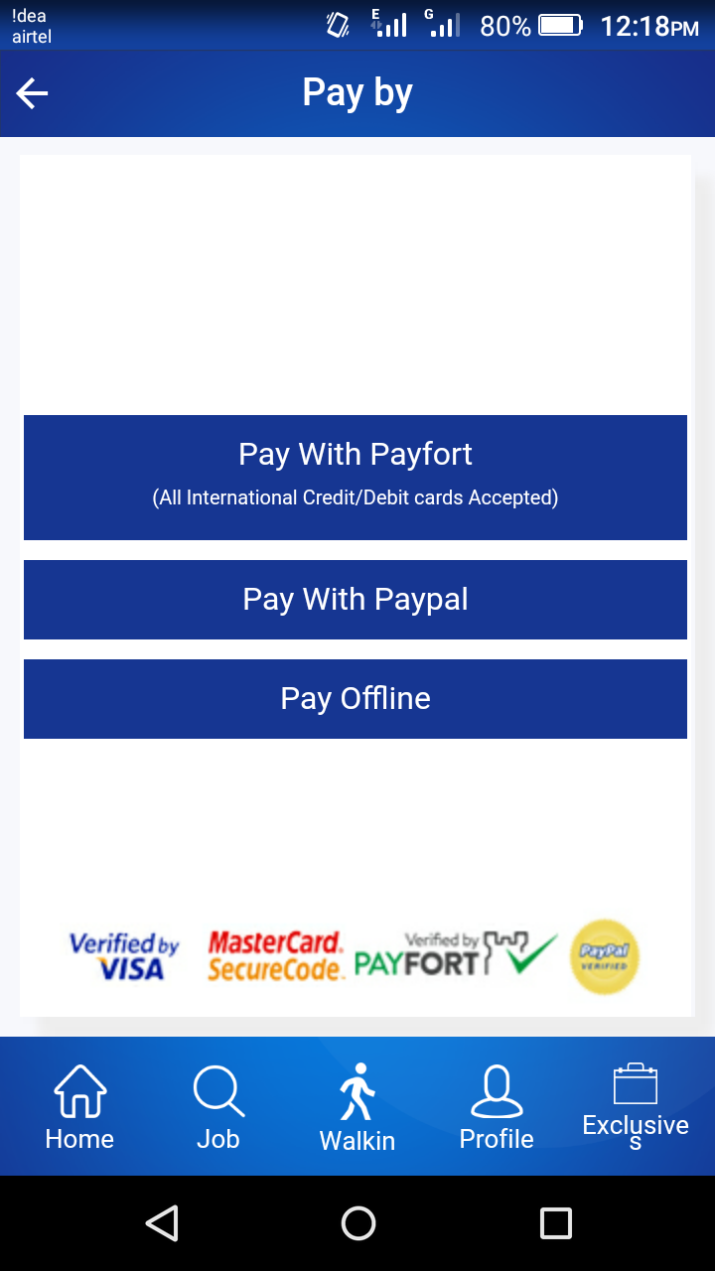

Slide 45
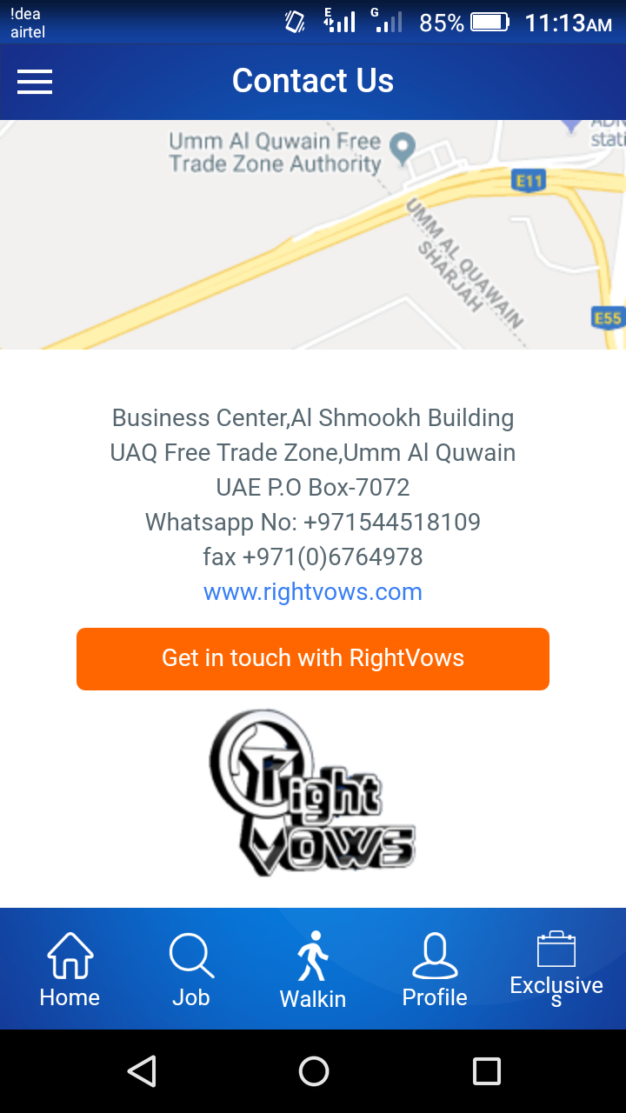
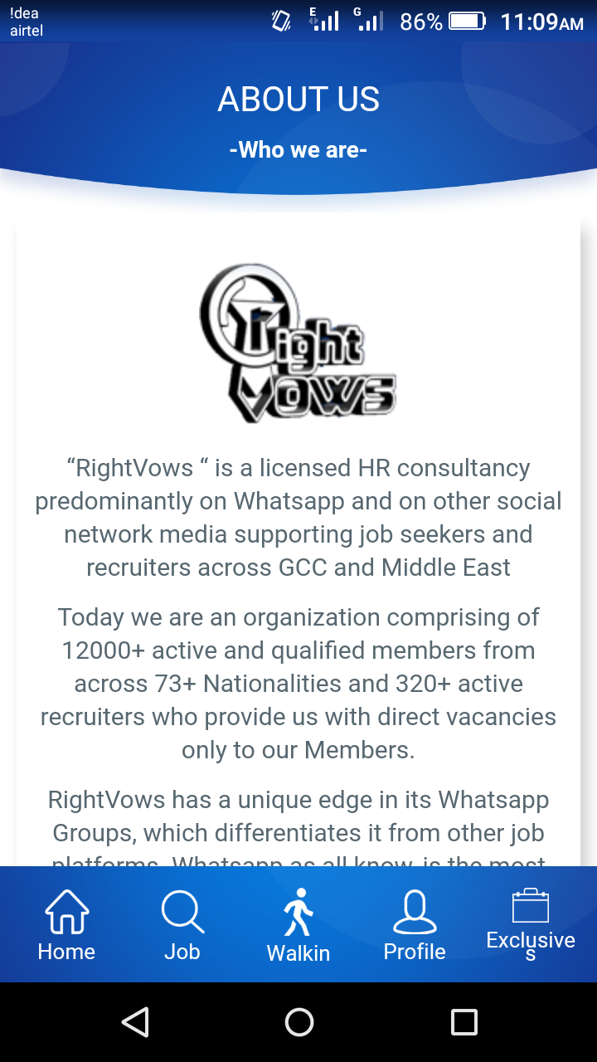

Slide 46
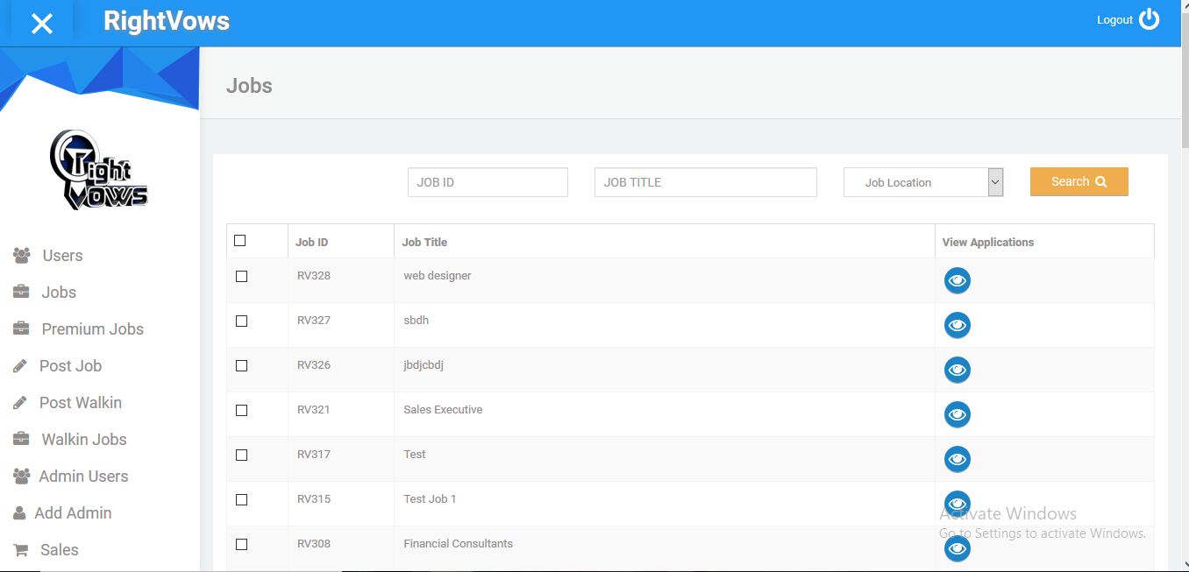
Web portal

Slide 47
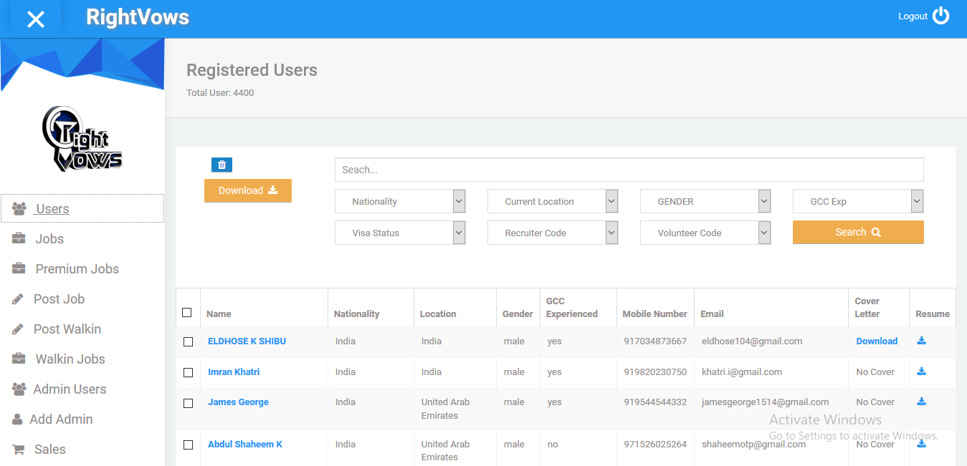

Slide 48


